Slide 1
Recursive acoustic transfer function (ATF)
estimation

Slide 2
General idea of the proposed method

Slide 3
Recursive implementation

Slide 4

Alternative RLS estimation of
$$R_{yy}^{−1}$$

Slide 5



Simulation settings
Uniform circular array [1]
Room size: 6.0m$×$6.0m$×$2.4m
Reverberation time: 250 ms
Interfering source (white noise)
Signal-to-interfering ratio: 20 dB
$∠$θ = 90º
Noise-free environment
1 m
Image source method (ISM) [2]
mic3
mic2
Target source
(Speech)
Without interfering source
mic4
mic1
1 m
$∠$θ = 0º
mic5
mic6

Slide 6
ATF measurements
Room impulse response (ground truth, RIR)
Reference clean signal (ATF-1)
Estimated clean signal using the MPDR (ATF-2)

Slide 7
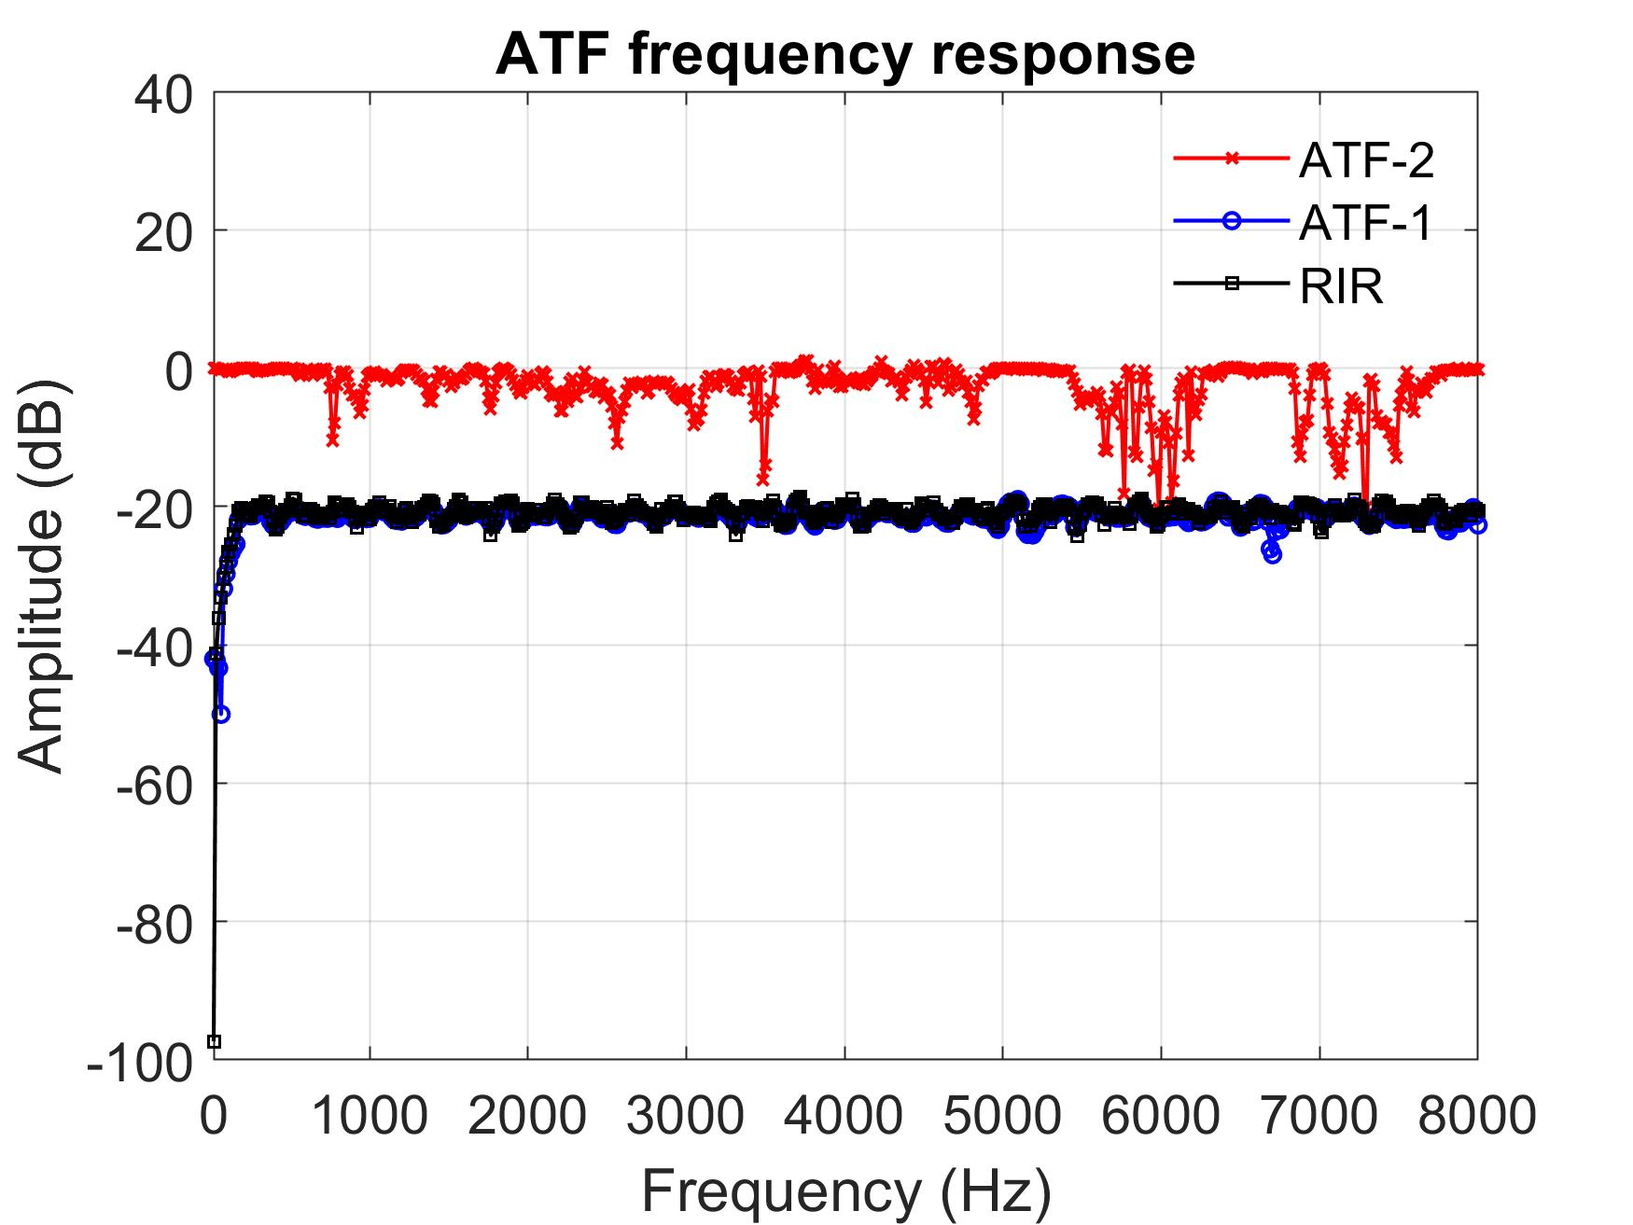
ATF frequency response with interfering source
Fig. 1 The ATF frequency response of ATF-2, ATF-1, and RIR for microphone 1.
SIR = 20 dB.

Slide 8
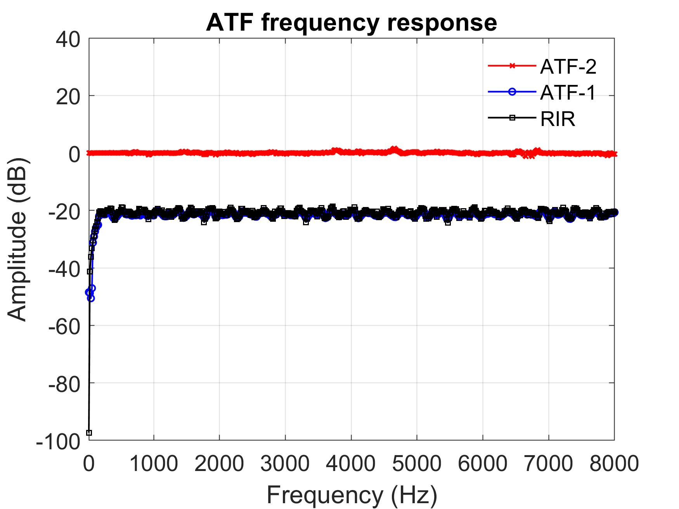
ATF frequency response without interfering source
Fig. 2 The ATF frequency response of ATF-2, ATF-1, and RIR for microphone 1.

Slide 9
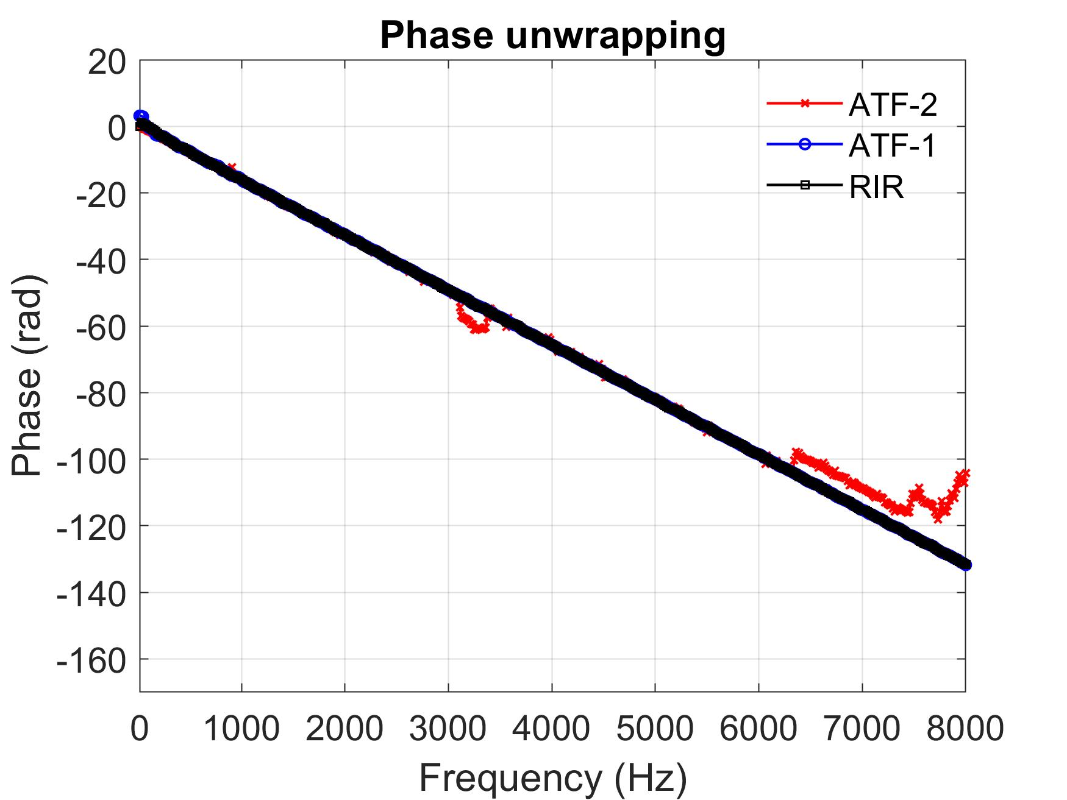
ATF unwrapping phase without interfering source
Fig. 3 The ATF unwrapping phase of ATF-2, ATF-1, and RIR for microphone 1.

Slide 10
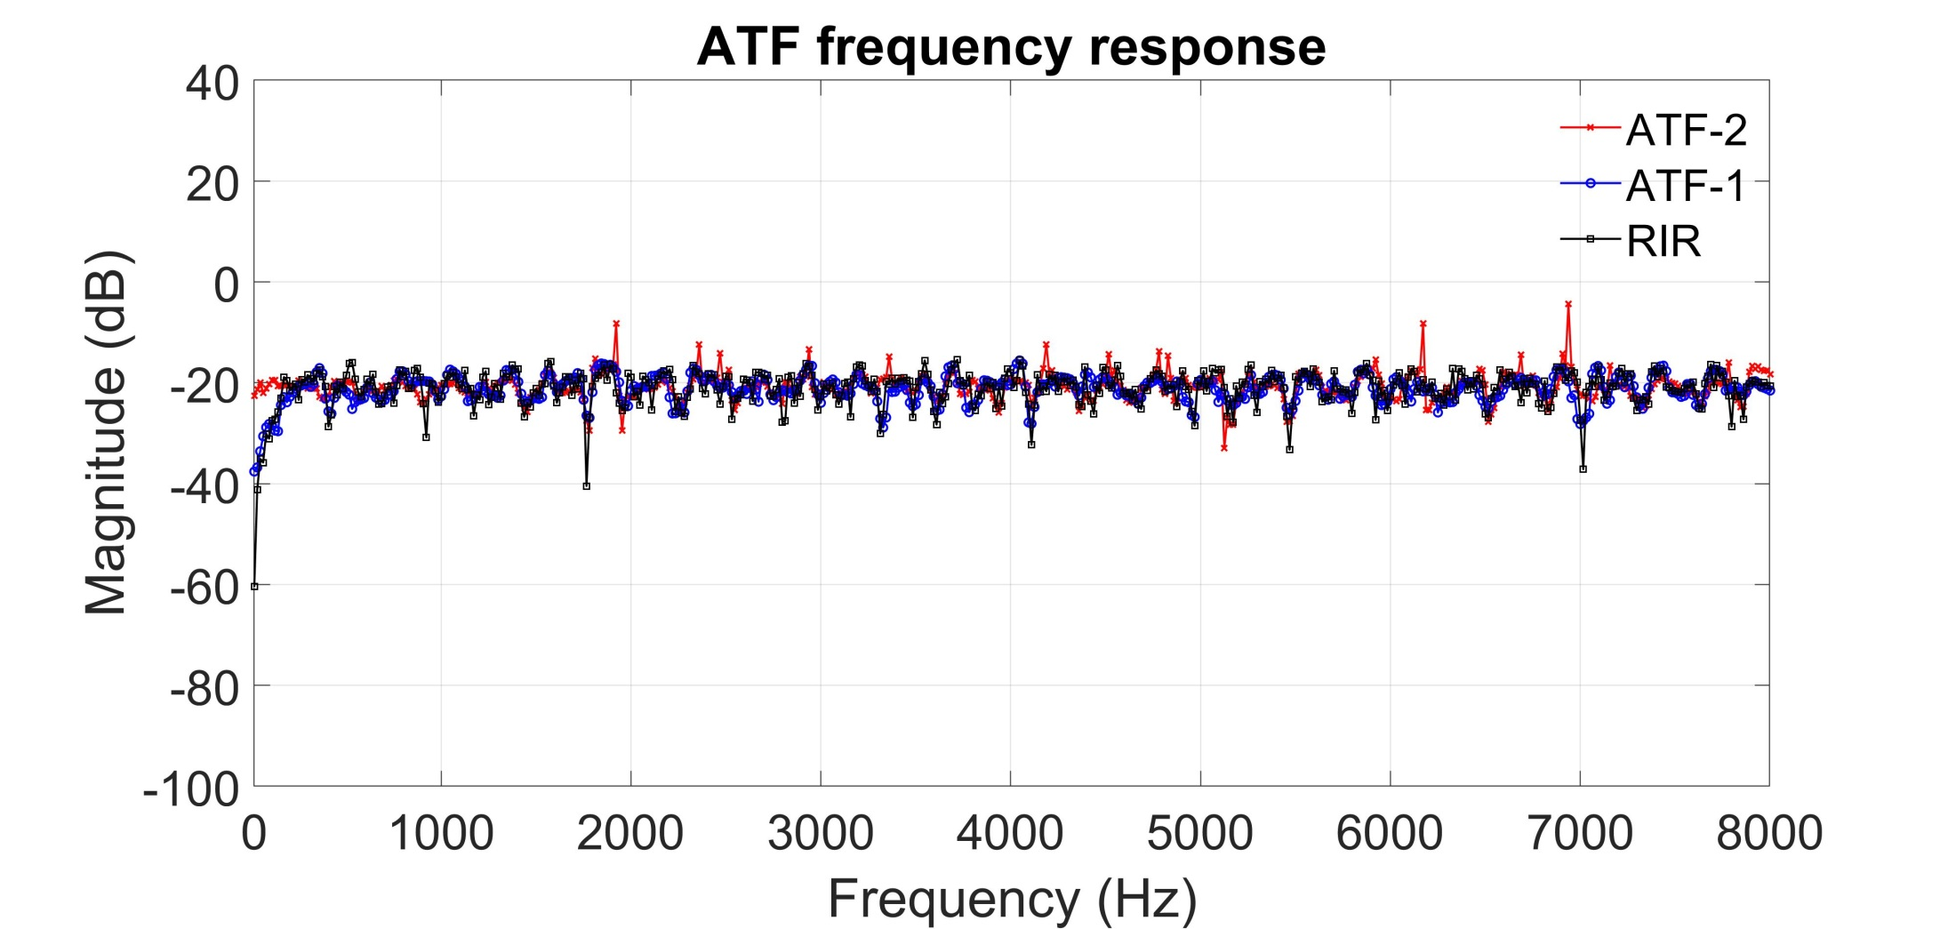
ATF frequency response with T60 = 0.16 s (white noise)
Fig. 1. The ATF frequency response of ATF-2, ATF-1, and RIR for microphone 1.
T60 = 0.16 s and SNR = 20 dB.

Slide 11
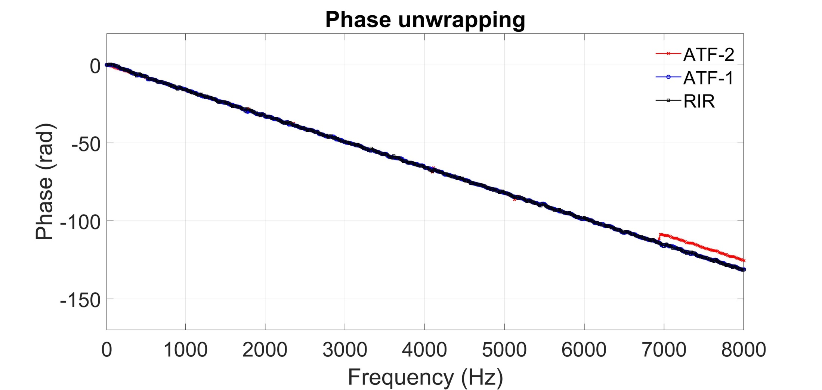
ATF unwrapping phase with T60 = 0.16 s (white noise)
Fig. 2. The ATF unwrapping phase of ATF-2, ATF-1, and RIR for microphone 1.
T60 = 0.16 s and SNR = 20 dB.

Slide 12

Speech enhancement with interfering source
Unprocessed signals
Processed signals

Slide 13
Speech enhancement without interfering source
Unprocessed signals
Processed signals

Slide 14
References
[1] N.H Noordin, V. Zuniga, A.O. El-Rayis, N. Haridas, A.T. Erdogan, and T. Arslan, “Uniform circular arrays for phased array antenna,” in Proc. 2011 Loughborough Antennas & Propagation Conference, Loughborough, UK, 2011, doi: 10.1109/LAPC.2011.6114031
[2] J. Allen and D. Berkley, “Image method for efficiently simulating small-room acoustics,” J. Acoust. Soc. Amer., vol. 65, pp. 943–950, 1979, doi: doi.org/10.1121/1.382599
Note
Our method requires the prior knowledge of the source location. → Needs a localization step.

Slide 15
Extension of Kung’s work
More simulations:
reverb, noise
Ground-truth, ATF-1, ATF-2
Compare MPDR BFs using freefield, RTF, ATF
CTF for large T60
RLS to compute R⁻¹
Whitening
Kalman filter
Multi-source ATFs
DNN
Blind system ID: ATF, Benesty’s approach
Applications: localization, beamforming, MINT, sensor & source interpolation, manifold learning, SOFI, room acoustics

Slide 16
Kalman filter implementation: single source
→need to know the source location in advance

Slide 17
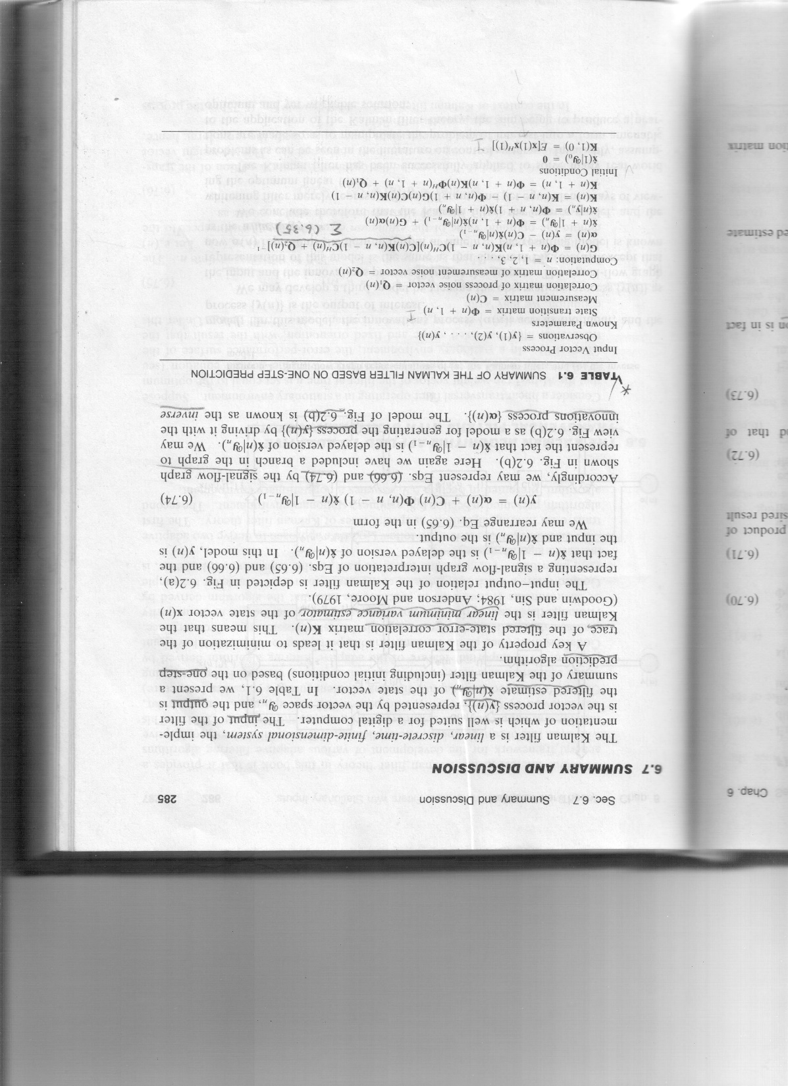
Basic formulation
The KF is formulated using the state-space model, in which a dynamical system is described by a finite set of states.
The process and measurement noises are assumed to be Gaussian, which enables a closed-form propagation model of second-order statistics (correlation matrices) and efficient computation of Kalman gain.

Slide 18
ATF vs. RTF
An ATF contains complete information of system poles (eigenvalues) and zeros (dependent on source and sensor positions) based on input-output signals.
An RTF contains only system zeros based on output signals.
De-reverberation using MINT amounts to cancellation of system poles and hence requires ATFs.
A major problem in identifying ATF is their length that is significantly influenced by T60.
→info of system poles, or reverb, is lost
→ inherently unstable due to NMP zeros

Slide 19
Tikhonove regularization: multi-source

Slide 20
Kalman filter implementation: multi-source
→need to know the source location in advance

Slide 21
Blind system ID: ATF, Benesty’s approach

Slide 22
Blind system ID
Question: There is still an EQ problem with this approach.

Slide 23
CTF model for long reverberation

Slide 24
Alternating Wiener filtering : single source (CTF)

Slide 25
Alternating Kalman filtering : single source (CTF)

Slide 26
Thank you.

